Slide 1



www.InfosoftTechnologies.co

info@InfosoftTechnologies.co
+91 85111 76717
NSIC REGISTERED MSME COMPANY

Slide 2




ENTERPRISE
GOVERNMENT
DIGITAL
INOVATION
| OUR VISION
| MISSION
Retention of Customer through
Solving Their Digital Needs
Driving Business through Digital Innovation for Seamless Business
Operations

Slide 3






Business / IT Consulting
Application Development
BUSINESS
VARTICALS
Cloud Services
Team Augmentation
Digitisation
e-Governance Projects

Slide 4
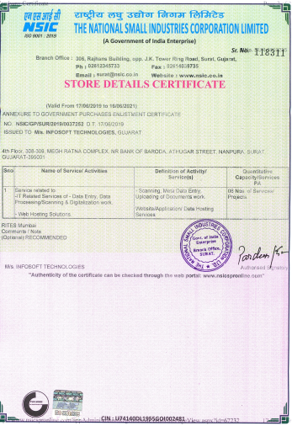
Certification
NSIC Certified MSME Unit
ISO 9001 : 2015 Certification

Slide 5
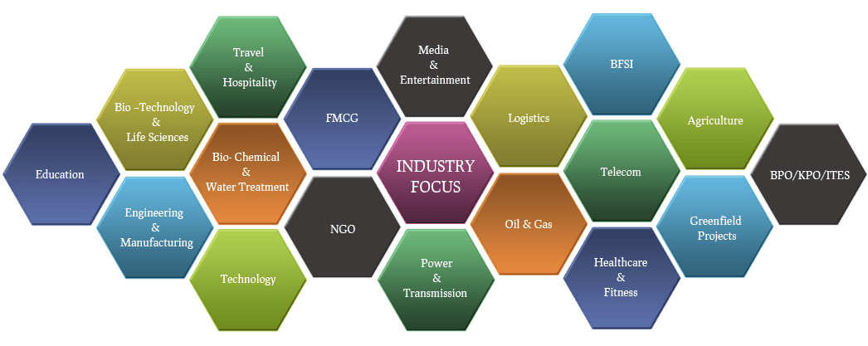
Industries
Government

Slide 6
Technology Expertise
MICROSOFT
OPEN SOURCE
MOBILE
FRONT END
UX/UI
DATABASE

Slide 7
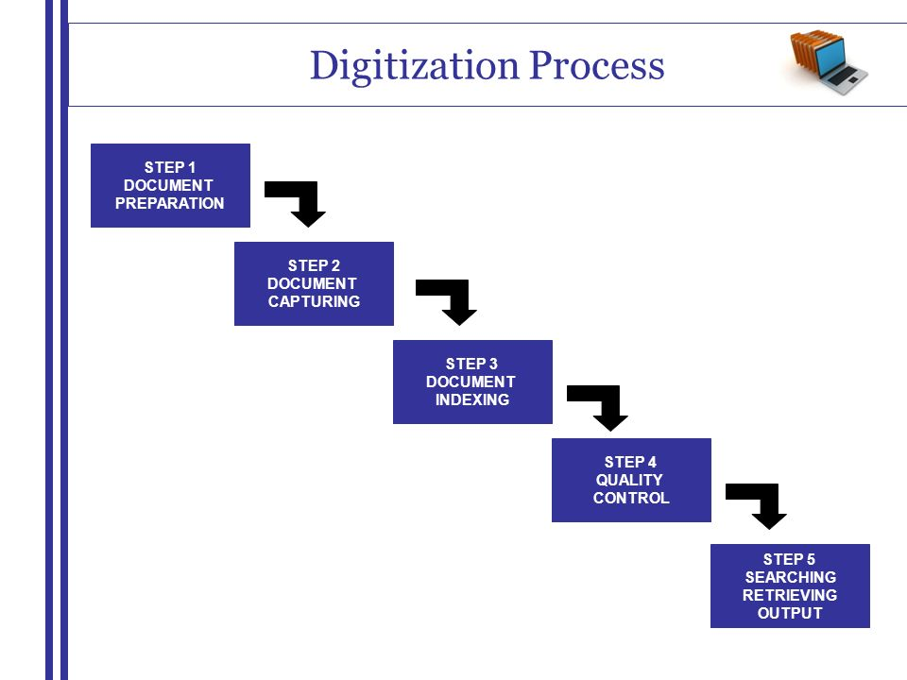
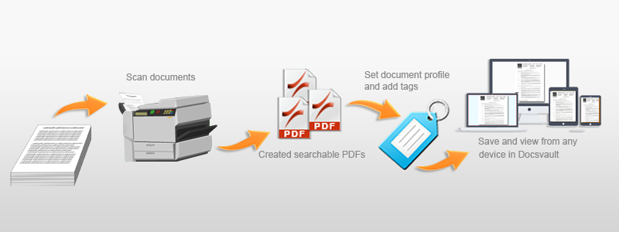

Slide 8








Some of Our Valued Client

Slide 9
About Mentor- “Trusted Sarthi”
We Heard that Lord Krishna was a good Mentor who shows the pathway to Arjuna in Mahabharata, he guide him by being his “Sarthi” in Mahabharata War, Same way in recent time every individual and businesses required good sarthi, who drives him/her towards path of Success in Unprecedented Time.
With the more than two decades of experience

Slide 10
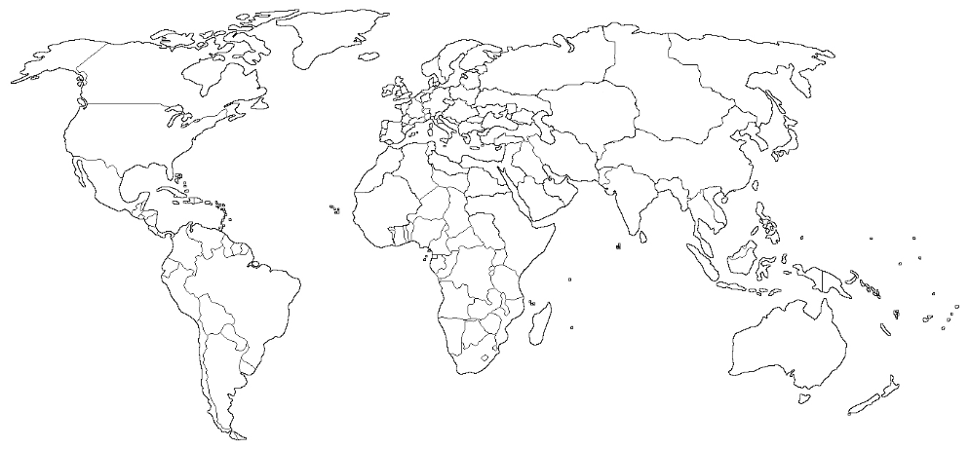

Our Presence
Surat
Navi mumbai
| REGISTERED OFFICE (SURAT,GUJARAT)
C/29-30, Kishor Park Society,
Behind St. Xavier’s High School,
Ghod Dod Road,
Surat – 395 001(Gujarat, India)
Infosoft Technologies

